Slide 1
PRESENT SIMPLE AND PRESENT CONTINUOUS

Slide 2
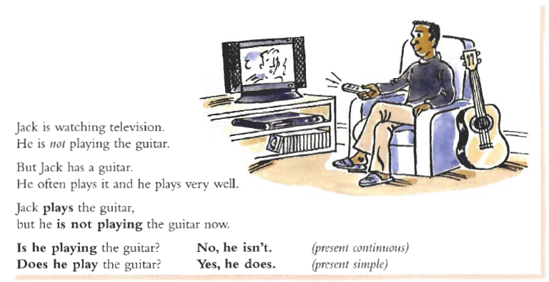

Slide 3
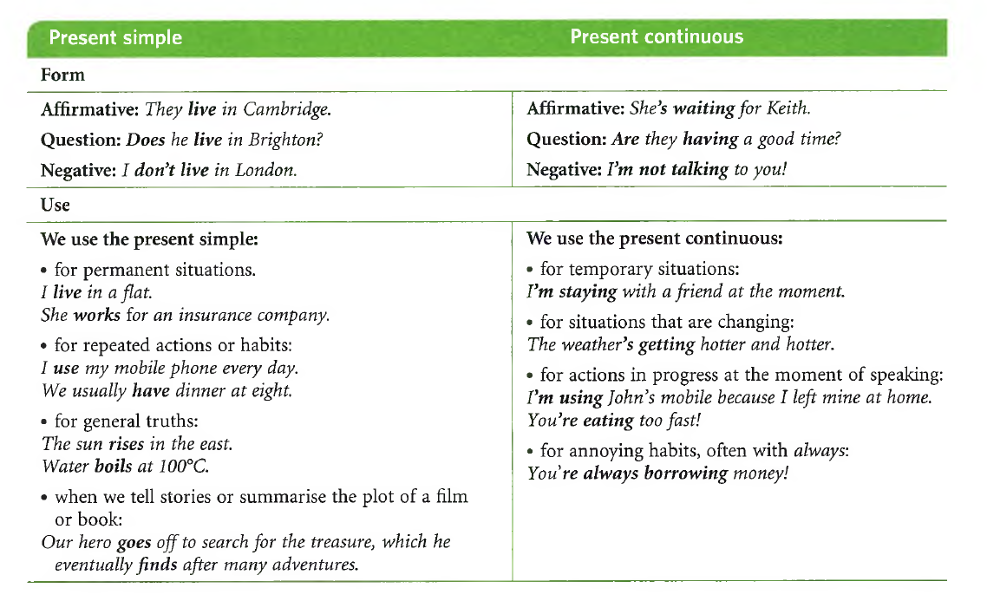

Slide 4
State verbs
We do not normally use certain verbs with the present continuous, or other continuous tenses. These verbs describe a state, not an activity. They are called state verbs and they include:
* mental/thinking verbs: agree, believe, disagree, doubt, expect, forget, imagine, know, notice, realise, remember, suppose, think, understand
♦ attitude verbs: dislike, hate, like, love, need, prefer, want, wish
♦ sense/perception verbs: hear, see, smell, taste
♦ appearance, qualities: appear, look, resemble, seem, sound
♦ existence, being, possession: be, belong to, come (from), exist, have, lack, own, possess
♦ other verbs: consist of, contain, cost, depend, fit, include, matter, mean, need, owe, suit, weigh

Slide 5
